Slide 1
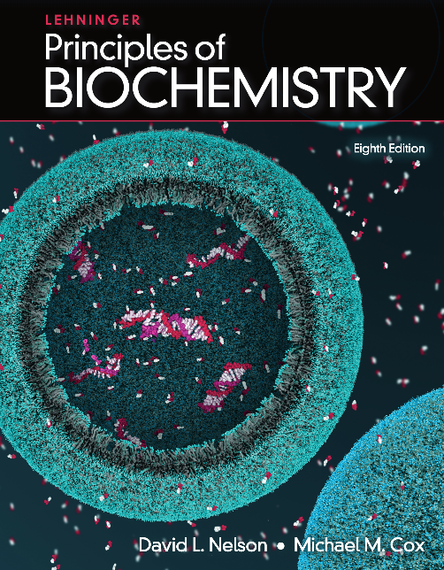
16 The Citric Acid Cycle
© 2021 Macmillan Learning

Slide 2
Cellular Respiration
cellular respiration = process by which the pyruvate produced by glycolysis is further oxidized to H₂O and CO₂

Slide 3
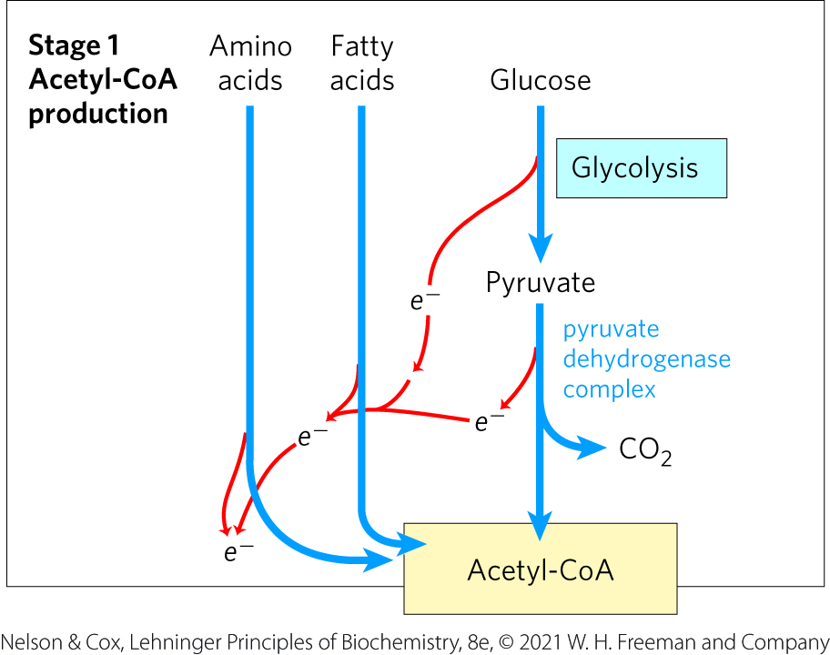
Stage 1 of Cellular Respiration
Stage 1: oxidation of fuels to acetyl-CoA
generates ATP, NADH, FADH₂

Slide 4
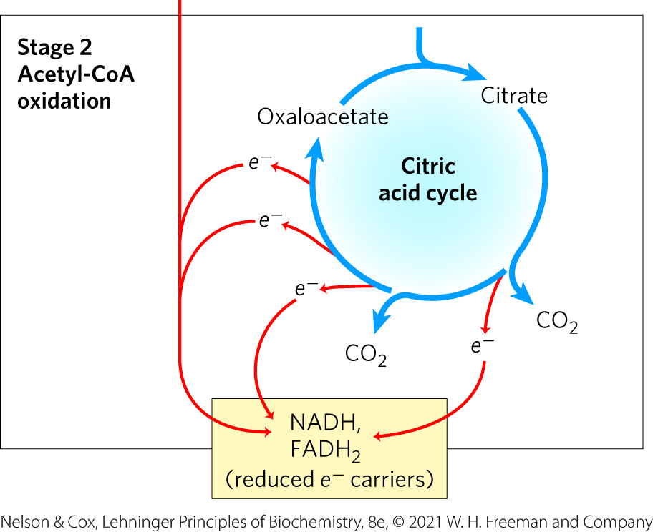
Stage 2 of Cellular Respiration
Stage 2: oxidation of acetyl groups to CO₂ in the citric acid cycle (tricarboxylic acid (TCA) cycle, Krebs cycle)
nearly universal pathway
generates NADH, FADH₂, and one GTP

Slide 5
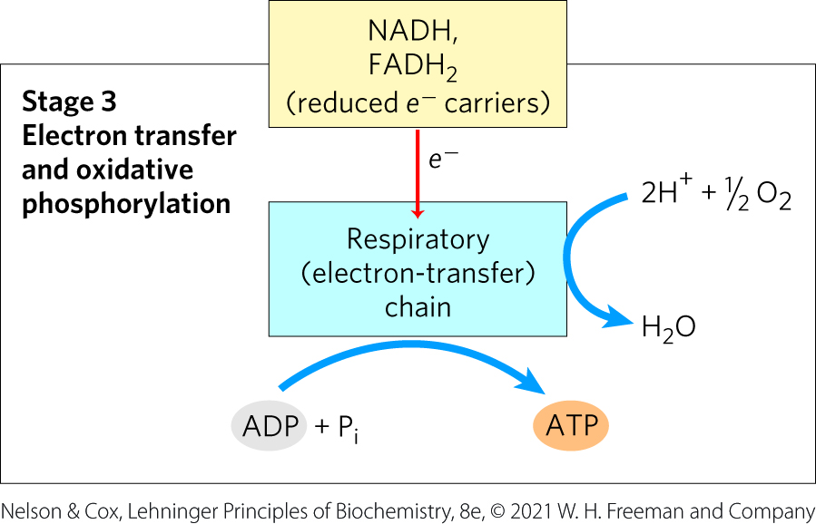
Stage 3 of Cellular Respiration
Stage 3: electron transfer chain and oxidative phosphorylation
generates the vast majority of ATP from catabolism

Slide 6
Principle 1 (1 of 4)
Pyruvate is the metabolite that links two central catabolic pathways, glycolysis and the citric acid cycle. It is therefore a logical point for regulation that determines the rate of catabolic activity and the partitioning of pyruvate among its possible uses.

Slide 7
Principle 2 (1 of 7)
The reactions of the citric acid cycle follow a chemical logic. In its catabolic role, the citric acid cycle oxidizes acetyl-CoA to CO₂ and H₂O. Energy from the oxidations in the cycle drives the synthesis of ATP. The chemical strategies for activating groups for oxidation and for conserving energy in the form of reducing power and high-energy compounds are used in many other biochemical pathways.

Slide 8
Principle 3 (1 of 4)
The citric acid cycle is a hub of metabolism, with catabolic pathways leading in and anabolic pathways leading out. Acetate groups (acetyl-CoA) from the catabolism of various fuels are used in the synthesis of such metabolites as amino acids, fatty acids, and sterols. The breakdown products of many amino acids and nucleotides are intermediates of the cycle, and they can be fed in or siphoned off as needed by the cell.

Slide 9
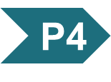
Principle 4 (1 of 5)
The central role of the citric acid cycle in metabolism requires that it be regulated in coordination with many other pathways. Regulation occurs by both allosteric and covalent mechanisms that overlap and interact to achieve homeostasis. Some mutations that affect the reactions of the citric acid cycle lead to tumor formation.

Slide 10
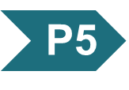
Principle 5 (1 of 6)
Enzymes have evolved to form complexes to efficiently achieve a series of chemical transformations without releasing the intermediates into the bulk solvent. This strategy, seen in the pyruvate dehydrogenase complex and the metabolons of the citric acid cycle, is ubiquitous in other pathways of metabolism, in respiration, and in the many “ — somes” that assemble and disassemble informational macromolecules.

Slide 11
16.1 Production of Acetyl-CoA (Activated Acetate)

Slide 12
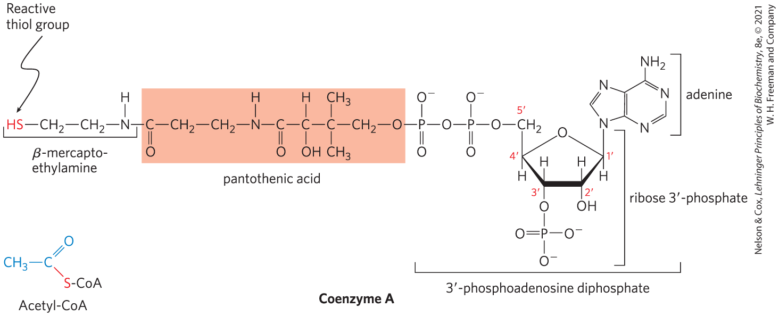
Coenzyme A (CoA-SH)
coenzyme A has a reactive thiol (–SH) group that is critical to its role as an acyl carrier
the –SH group forms a thioester with acetate in acetyl-CoA

Slide 13
Principle 1 (2 of 4)
Pyruvate is the metabolite that links two central catabolic pathways, glycolysis and the citric acid cycle. It is therefore a logical point for regulation that determines the rate of catabolic activity and the partitioning of pyruvate among its possible uses.

Slide 14
Principle 5 (2 of 6)
Enzymes have evolved to form complexes to efficiently achieve a series of chemical transformations without releasing the intermediates into the bulk solvent. This strategy, seen in the pyruvate dehydrogenase complex and the metabolons of the citric acid cycle, is ubiquitous in other pathways of metabolism, in respiration, and in the many “ — somes” that assemble and disassemble informational macromolecules.

Slide 15
Principle 4 (2 of 5)
The central role of the citric acid cycle in metabolism requires that it be regulated in coordination with many other pathways. Regulation occurs by both allosteric and covalent mechanisms that overlap and interact to achieve homeostasis. Some mutations that affect the reactions of the citric acid cycle lead to tumor formation.

Slide 16
Pyruvate Is Oxidized to Acetyl-CoA and CO₂
mitochondrial pyruvate carrier (MPC) = an H⁺-coupled pyruvate-specific symporter in the inner mitochondrial membrane
pyruvate dehydrogenase (PDH) complex = highly ordered cluster of enzymes and cofactors that oxidizes pyruvate in the mitochondrial matrix to acetyl-CoA and CO₂
the series of chemical intermediates remain bound to the enzyme subunits
regulation results in precisely regulated flux

Slide 17
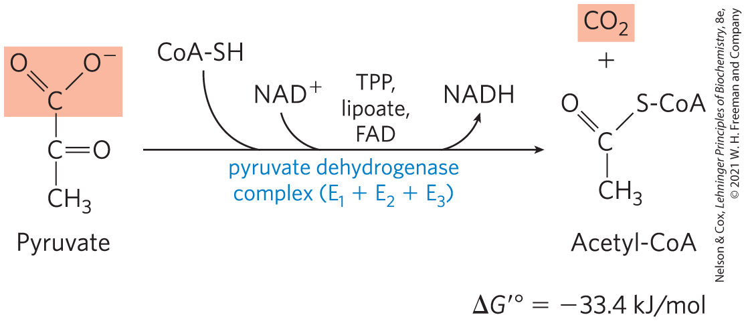
The PDH Complex Catalyzes an Oxidative Decarboxylation
oxidative decarboxylation = an irreversible oxidation process in which the carboxyl group is removed, forming CO₂

Slide 18
The PDH Complex Employs Three Enzymes and Five Coenzymes to Oxidize Pyruvate
three enzymes:
pyruvate dehydrogenase, E₁
dihydrolipoyl transacetylase, E₂
dihydrolipoyl dehydrogenase, E₃
five coenzymes:
thiamine pyrophosphate (TPP)
lipoate
coenzyme A (CoA, CoA-SH)
flavin adenine dinucleotide (FAD)
nicotinamide adenine dinucleotide (NAD)

Slide 19
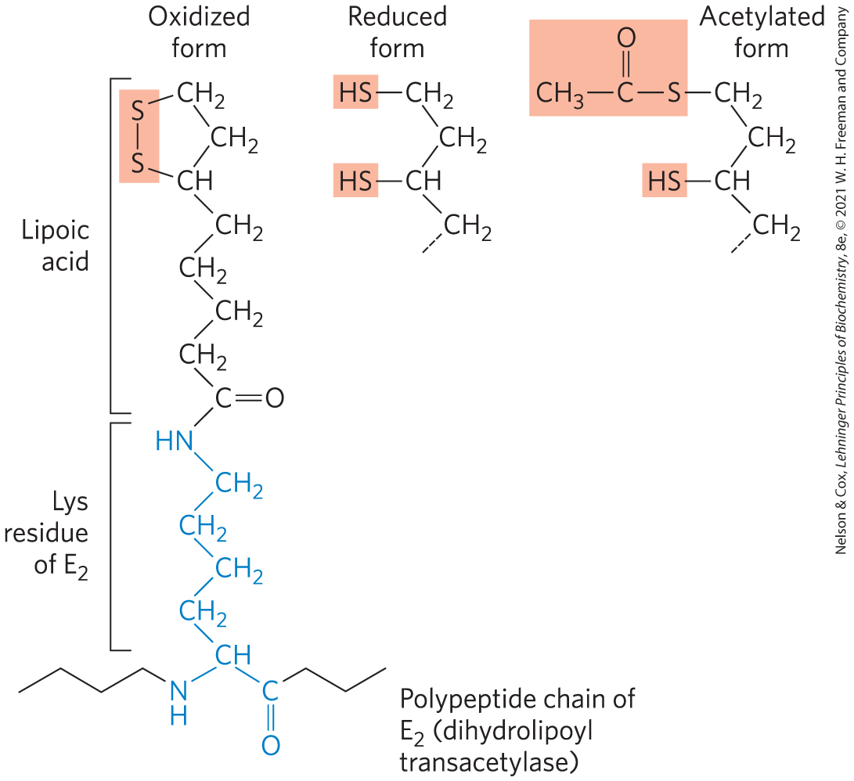
Lipoate
lipoate = coenzyme with two thiol groups that can undergo reversible oxidation to a disulfide bond (–S–S–)
serves as an electron (hydrogen) carrier and an acyl carrier
covalently linked to E₂ via a lysine residue

Slide 20
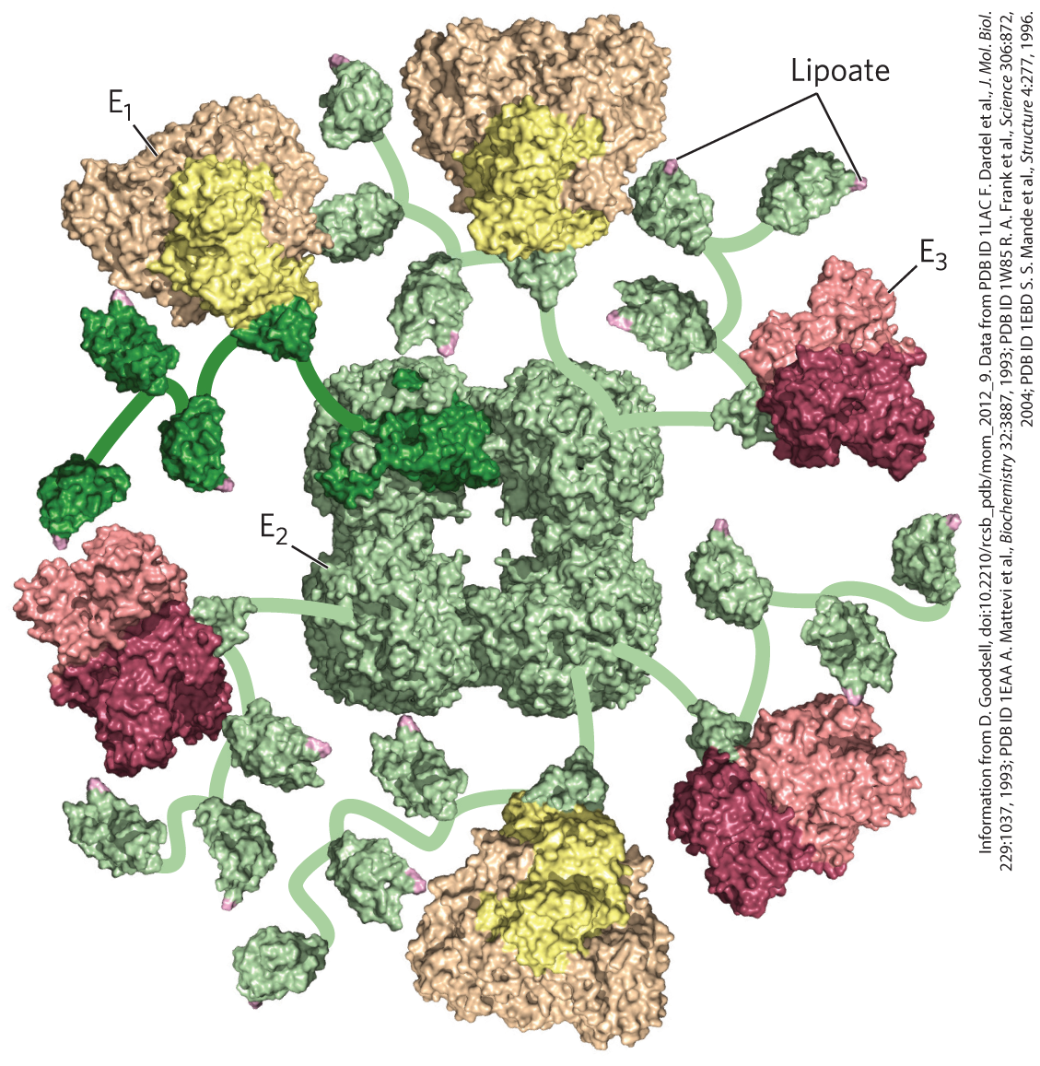
The PDH Complex Enzymes
the PDH complex contains multiple copies of:
pyruvate dehydrogenase (E₁)
dihydrolipoyl transacetylase (E₂)
dihydrolipoyl dehydrogenase (E₃)
an E₂ core (of 24-60 copies) is surrounded by multiple and variable numbers of E₁ and E₃ copies

Slide 21
Principle 5 (3 of 6)
Enzymes have evolved to form complexes to efficiently achieve a series of chemical transformations without releasing the intermediates into the bulk solvent. This strategy, seen in the pyruvate dehydrogenase complex and the metabolons of the citric acid cycle, is ubiquitous in other pathways of metabolism, in respiration, and in the many “ — somes” that assemble and disassemble informational macromolecules.

Slide 22
The E₁-E₂-E₃ Structure of the PDH Complex
the structure of the PDH complex is similar to other enzymes that catalyze oxidations:
α-ketoglutarate dehydrogenase
branched-chain α-keto acid dehydrogenase
in a given species, E₃ is identical in all three complexes
similarities reflect a common evolutionary origin
they are paralogs

Slide 23
Principle 5 (4 of 6)
Enzymes have evolved to form complexes to efficiently achieve a series of chemical transformations without releasing the intermediates into the bulk solvent. This strategy, seen in the pyruvate dehydrogenase complex and the metabolons of the citric acid cycle, is ubiquitous in other pathways of metabolism, in respiration, and in the many “ — somes” that assemble and disassemble informational macromolecules.

Slide 24
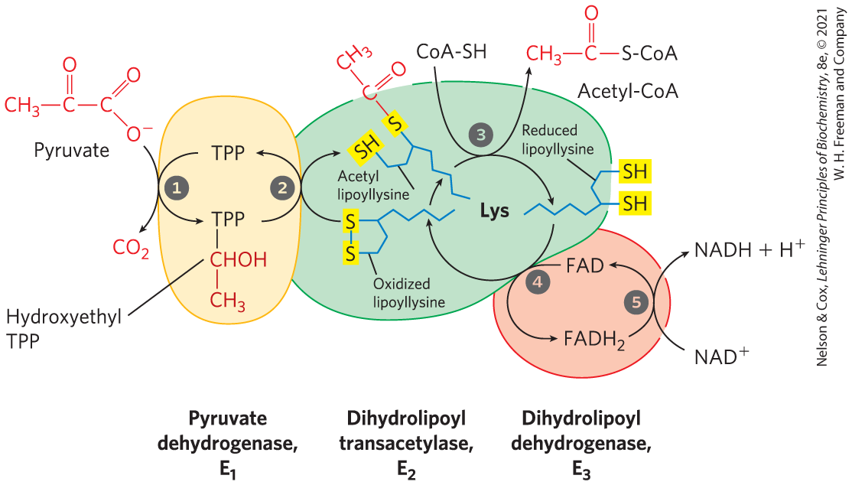
The PDH Complex Channels Its Intermediates through Five Reactions

Slide 25
Oxidative Decarboxylation of Pyruvate - Steps 1 and 2
pyruvate dehydrogenase, E₁, with bound TPP catalyzes:
step 1: decarboxylation of pyruvate to the hydroethyl derivate
rate-limiting step
step 2: oxidation of the hydroethyl derivate to an acetyl group
electrons and the acetyl group are transferred from TPP to the lipoyllysyl group of E₂

Slide 26
Oxidative Decarboxylation of Pyruvate - Steps 3-5
dihydrolipoyl transacetylase, E₂, catalyzes:
step 3: esterification of the acetyl moiety to one of the lipoyl –SH groups, followed by transesterification to CoA to form acetyl-CoA
dihydrolipoyl dehydrogenase, E₃, catalyzes:
step 4: electron transfer to regenerate the oxidized form of the lipoyllysyl group
step 5: electron transfer to regenerate the oxidized FAD cofactor, forming NADH

Slide 27
Principle 5 (5 of 6)
Enzymes have evolved to form complexes to efficiently achieve a series of chemical transformations without releasing the intermediates into the bulk solvent. This strategy, seen in the pyruvate dehydrogenase complex and the metabolons of the citric acid cycle, is ubiquitous in other pathways of metabolism, in respiration, and in the many “ — somes” that assemble and disassemble informational macromolecules.

Slide 28
The Five-Reaction Sequence of the PDH Complex Is An Example of Substrate Channeling
substrate channeling = the passage of intermediates from one enzyme directly to another enzyme without release
the long lipoyllysyl arm of E₂ channels the substrate from the active site of E₁ to E₂ to E₃
tethers intermediates to the enzyme complex
increases the efficiency of the overall reaction
minimizes side reactions

Slide 29
16.2 Reactions of the Citric Acid Cycle

Slide 30
Principle 2 (2 of 7)
The reactions of the citric acid cycle follow a chemical logic. In its catabolic role, the citric acid cycle oxidizes acetyl-CoA to CO₂ and H₂O. Energy from the oxidations in the cycle drives the synthesis of ATP. The chemical strategies for activating groups for oxidation and for conserving energy in the form of reducing power and high-energy compounds are used in many other biochemical pathways.

Slide 31
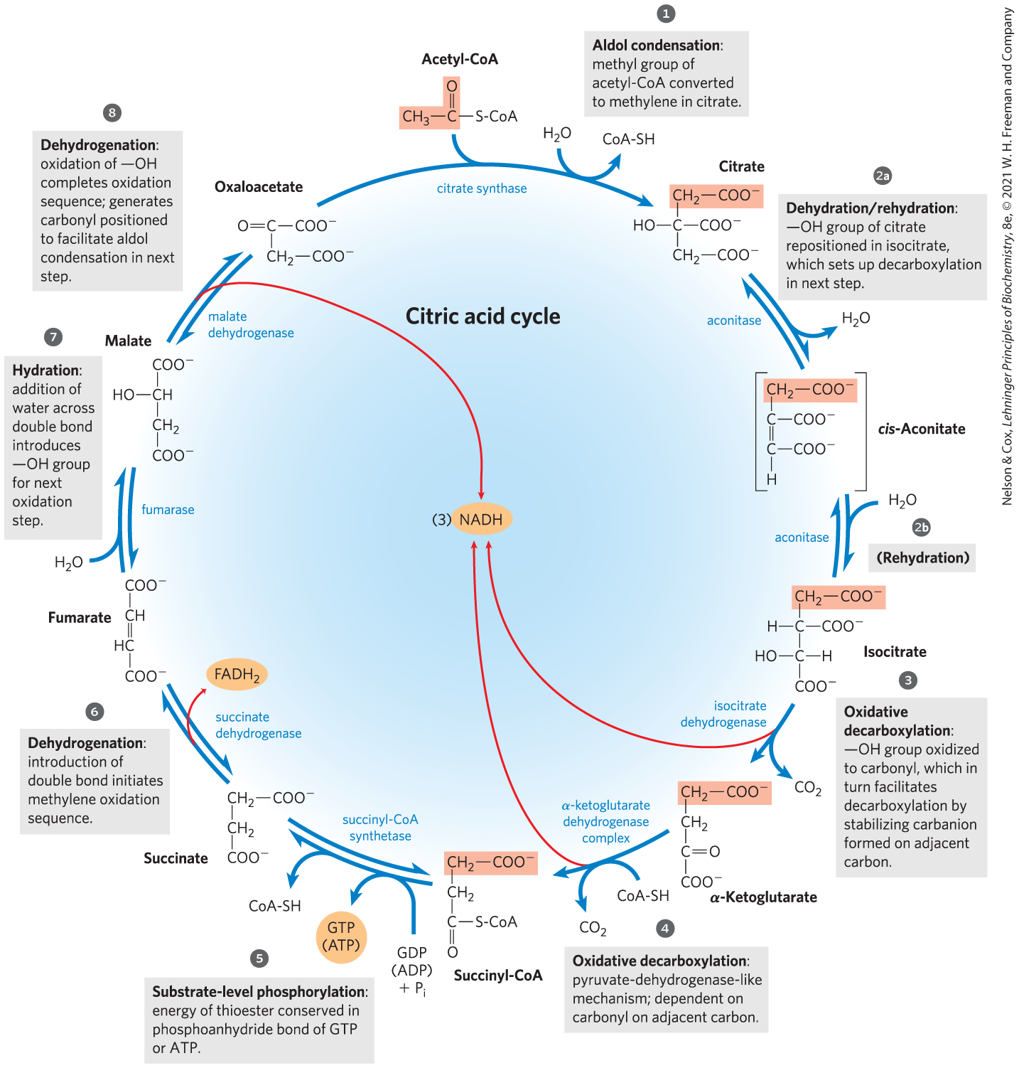
Reactions of the Citric Acid Cycle
one oxaloacetate molecule can theoretically oxidize an infinite number of acetyl groups
energy from the four oxidations is conserved as NADH and FADH₂

Slide 32
In Eukaryotes, the Mitochondrion Is the Site of Energy-Yielding Oxidative Reactions and ATP Synthesis
isolated mitochondria contain all enzyme, coenzymes, and proteins needed for:
the citric acid cycle
electron transfer and ATP synthesis by oxidative phosphorylation
oxidation of fatty acids and amino acids to acetyl-CoA
oxidative degradation of amino acids to citric acid cycle intermediates

Slide 33
Principle 2 (3 of 7)
The reactions of the citric acid cycle follow a chemical logic. In its catabolic role, the citric acid cycle oxidizes acetyl-CoA to CO₂ and H₂O. Energy from the oxidations in the cycle drives the synthesis of ATP. The chemical strategies for activating groups for oxidation and for conserving energy in the form of reducing power and high-energy compounds are used in many other biochemical pathways.

Slide 34
The Sequence of Reactions in the Citric Acid Cycle Makes Chemical Sense
complete oxidation of acetyl-CoA to CO₂ extracts the maximum potential energy
direct oxidation to yield CO₂ and CH₄ is not biochemically feasible because organisms cannot oxidize CH₄

Slide 35
Principle 2 (4 of 7)
The reactions of the citric acid cycle follow a chemical logic. In its catabolic role, the citric acid cycle oxidizes acetyl-CoA to CO₂ and H₂O. Energy from the oxidations in the cycle drives the synthesis of ATP. The chemical strategies for activating groups for oxidation and for conserving energy in the form of reducing power and high-energy compounds are used in many other biochemical pathways.

Slide 36
The Chemical Logic of the Citric Acid Cycle
carbonyl groups are more chemically reactive than a methylene group or methane
each step of the cycle involves either:
an energy-conserving oxidation
placing functional groups in position to facilitate oxidation or oxidative decarboxylation

Slide 37
The Citric Acid Cycle Has Eight Steps
citrate formed from acetyl-CoA and oxaloacetate is oxidized to yield:
CO₂
NADH
FADH₂
GTP or ATP

Slide 38
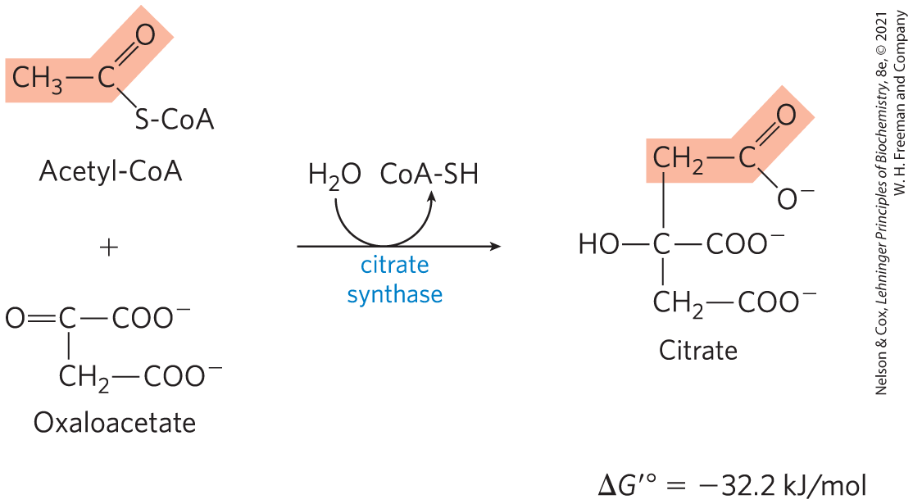
Formation of Citrate
citrate synthase = catalyzes the condensation of acetyl-CoA with oxaloacetate to form citrate
involves the formation of a transient intermediate, citroyl-CoA
large, negative ∆G′° is needed because [oxaloacetate] is normally very low

Slide 39
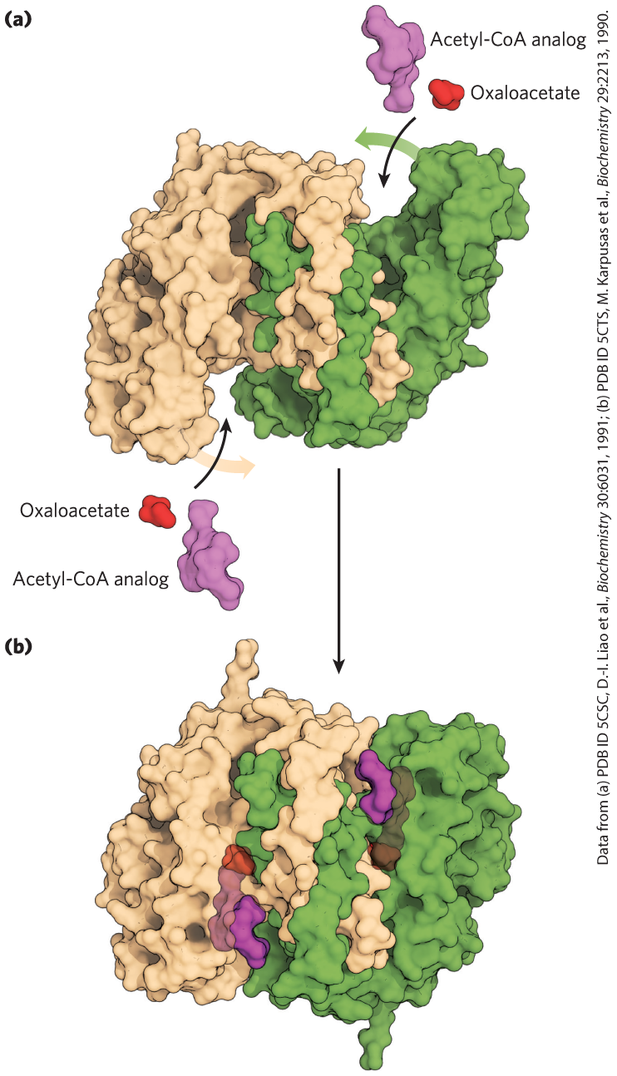
Structure of Citrate Synthase
binding of oxaloacetate creates a binding site for acetyl-CoA
induced fit decreases the likelihood of premature cleavage of the thioester bond of acetyl-CoA

Slide 40
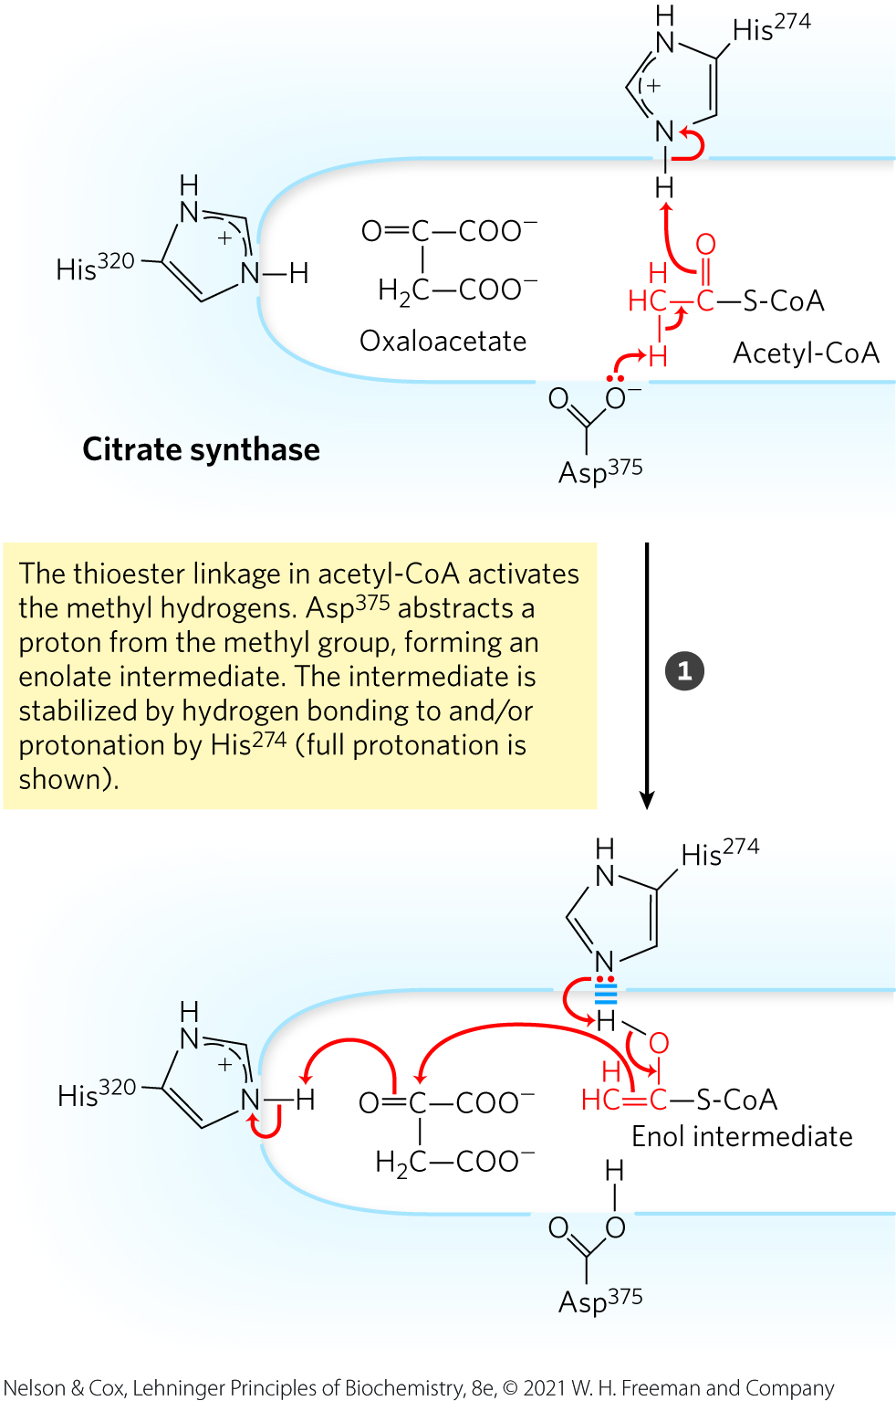
Mechanism of Citrate Synthase: Acid/Base Catalysis

Slide 41
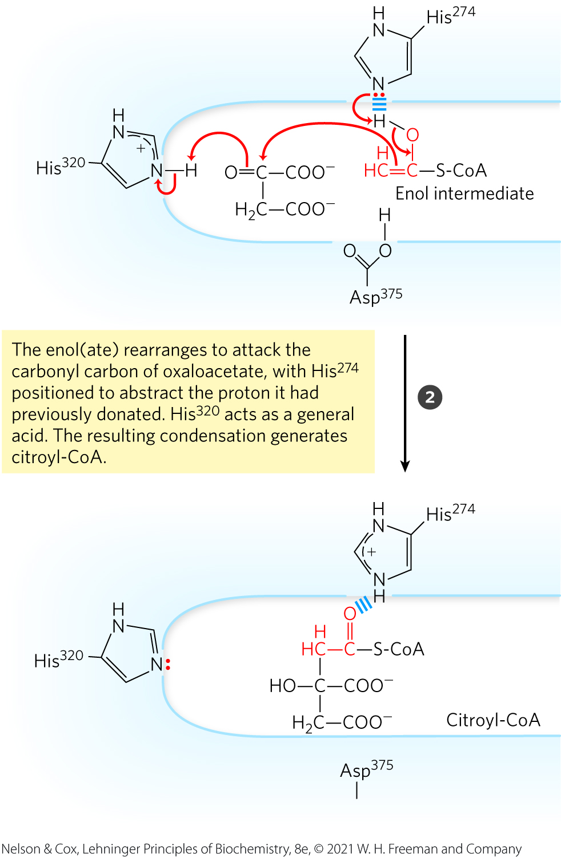
Mechanism of Citrate Synthase: Acid/Base Catalysis, Continued

Slide 42
Mechanism of Citrate Synthase: Thioester Hydrolysis

Slide 43
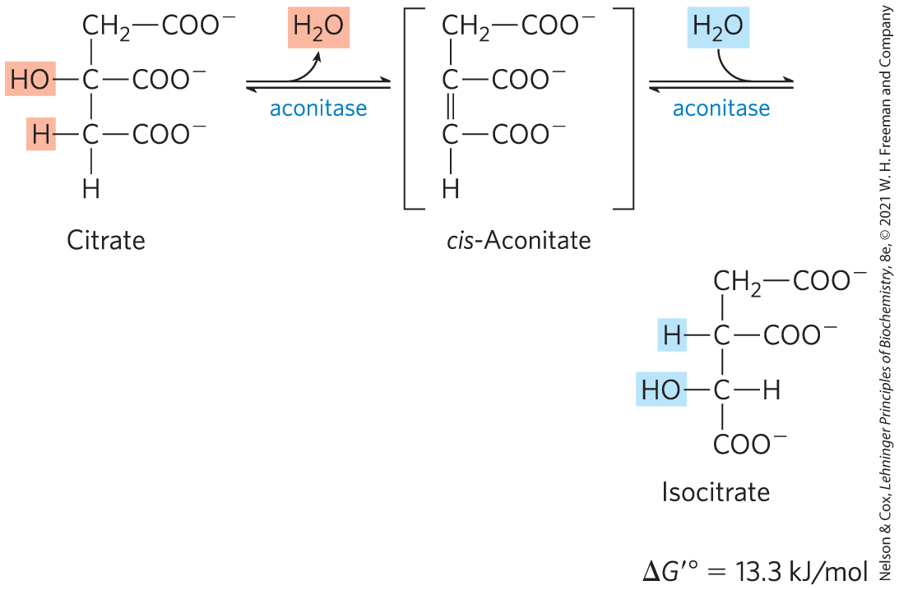
Formation of Isocitrate via Cis-Aconitate
aconitase (aconitate hydratase) = catalyzes the reversible transformation of citrate to isocitrate through the intermediate cis-aconitate
addition of H₂O to cis-aconitate is stereospecific
low [isocitrate] pulls the reaction forward

Slide 44
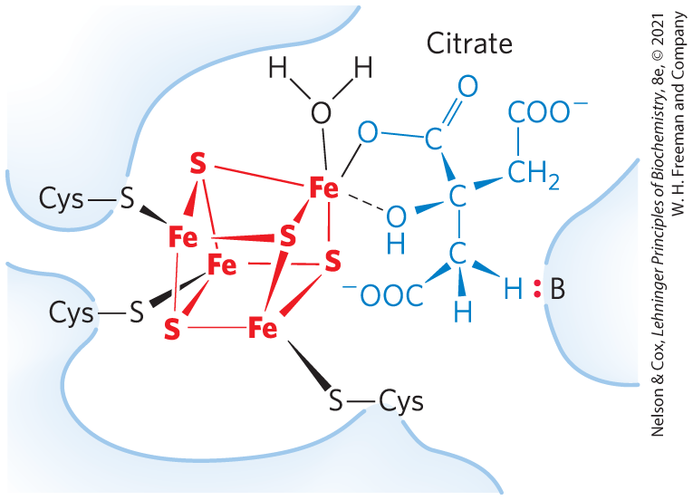
Iron-Sulfur Center in Aconitase
iron-sulfur center = acts both in the binding of the substrate to the active site and in the catalytic addition or removal of H₂O

Slide 45
Oxidation of Isocitrate to α-Ketoglutarate and CO₂
isocitrate dehydrogenase = catalyzes the oxidative decarboxylation of isocitrate to α-ketoglutarate
Mn²⁺ interacts with the carbonyl group of the oxalosuccinate and stabilizes the transiently-formed enol
specific isozymes for NADP⁺ (cytosolic and mitochondrial) or NAD⁺ (mitochondrial)

Slide 46
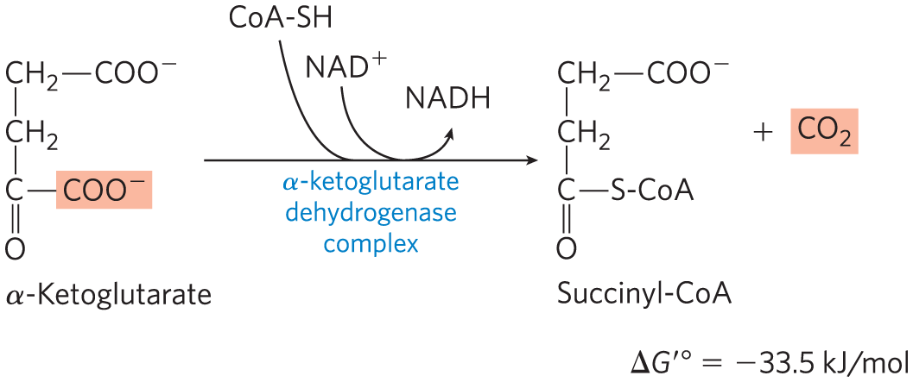
Oxidation of α-Ketoglutarate to Succinyl-CoA and CO₂
α-ketoglutarate dehydrogenase complex = catalyzes the oxidative decarboxylation of α-ketoglutarate to succinyl-CoA and CO₂
energy of oxidation is conserved in the thioester bond of succinyl-CoA

Slide 47
Principle 2 (5 of 7)
The reactions of the citric acid cycle follow a chemical logic. In its catabolic role, the citric acid cycle oxidizes acetyl-CoA to CO₂ and H₂O. Energy from the oxidations in the cycle drives the synthesis of ATP. The chemical strategies for activating groups for oxidation and for conserving energy in the form of reducing power and high-energy compounds are used in many other biochemical pathways.

Slide 48
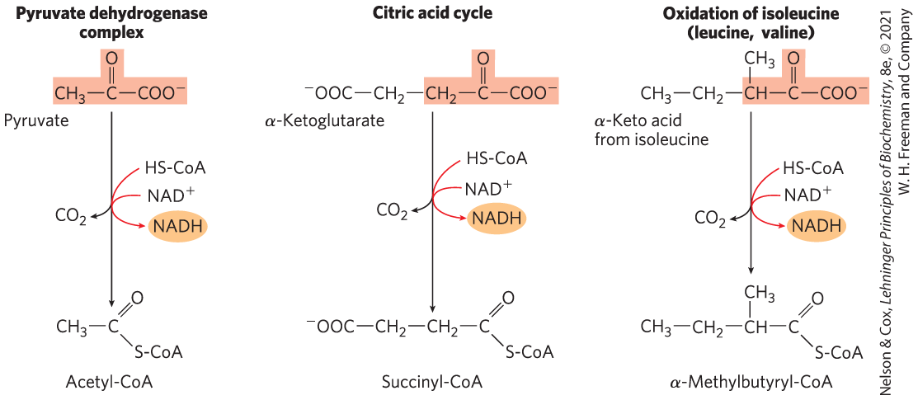
A Conserved Mechanism for Oxidative Decarboxylation
pathways use the same five cofactors, similar multienzyme complexes, and the same enzymatic mechanism
have homologous E₁ and E₂ and identical E₃
example of gene duplication and divergent evolution

Slide 49
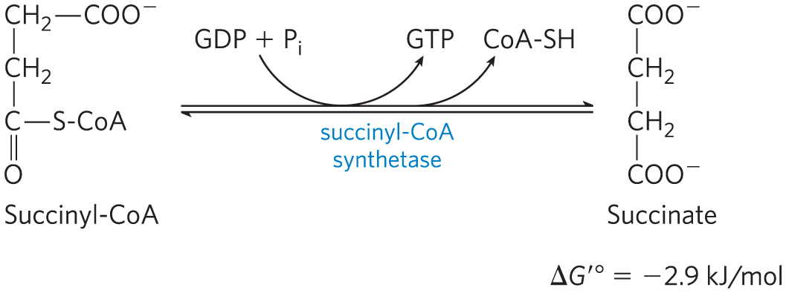
Conversion of Succinyl-CoA to Succinate
succinyl-CoA synthetase (succinic thiokinase) = catalyzes the breakage of the thioester bond of succinyl-CoA to form succinate
energy released drives the synthesis of a phosphoanhydride bond in either GTP or ATP (substrate level phosphorylation)

Slide 50
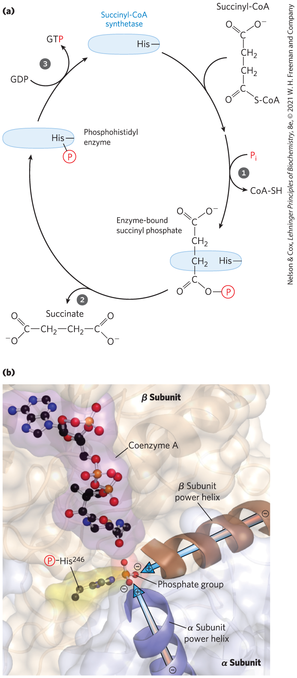
The Succinyl-CoA Synthetase Reaction (1 of 2)
enzyme molecule becomes phosphorylated at a His residue in the active site
phosphoryl group is then transferred to ADP or GDP to form ATP or GTP
animal cells have specific isozymes for ADP and GDP

Slide 51
The Succinyl-CoA Synthetase Reaction (2 of 2)
power helices place the partial positive charges of the helix dipole near the phosphate group of the α chain phosphorylated His²⁴⁶ to stabilize the phosphoenzyme intermediate

Slide 52
Nucleoside Diphosphate Kinase
nucleoside diphosphate kinase = catalyzes the reversible conversion of GTP and ATP
GTP + ADP $⇌$ GDP + ATP ∆G′° = 0 kJ/mol
net result of the activity of either isozyme of succinyl-CoA synthetase is the conservation of energy as ATP

Slide 53
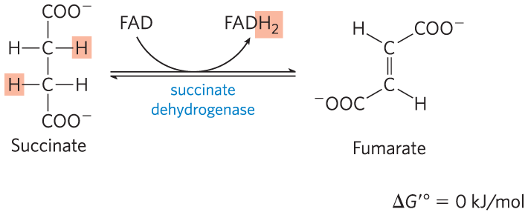
Oxidation of Succinate to Fumarate
succinate dehydrogenase = flavoprotein that catalyzes the reversible oxidation of succinate to fumarate
integral protein of the mitochondrial inner membrane in eukaryotes
contains three iron-sulfur clusters and covalently bound FAD

Slide 54
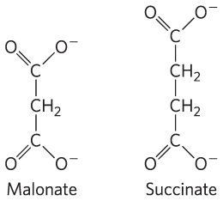
Malonate Is a Strong Competitive Inhibitor of Succinate Dehydrogenase
malonate = an analog of succinate
not normally present in cells
addition to mitochondria in vitro blocks citric acid cycle activity

Slide 55
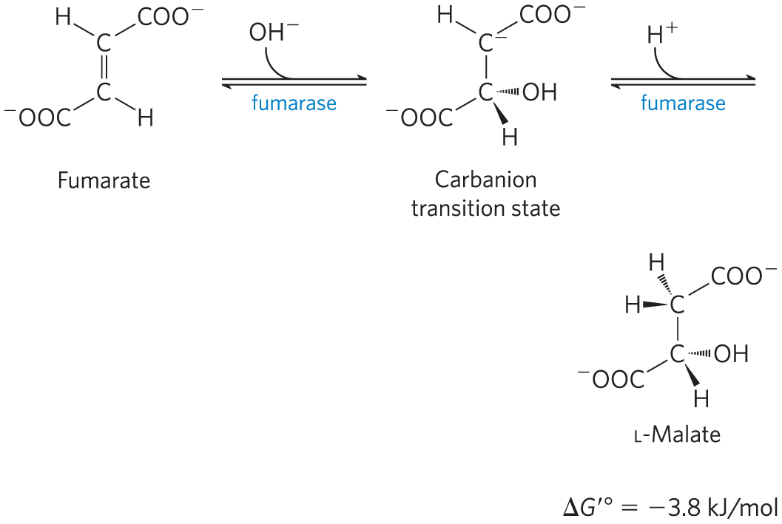
Hydration of Fumarate to Malate
fumarase = catalyzes the reversible hydration of fumarate to L-malate
transition state is a carbanion

Slide 56
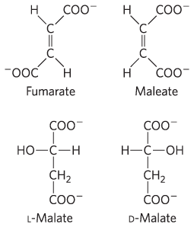
Fumarase Is Highly Stereospecific
in the forward direction, fumarase catalyzes hydration of the trans double bond of fumarate but not the cis double bond of maleate
in the reverse direction, fumarase is equally stereospecific

Slide 57
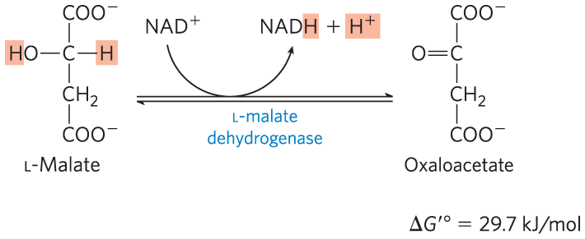
Oxidation of Malate to Oxaloacetate
L-malate dehydrogenase = catalyzes the oxidation of L-malate to oxaloacetate, coupled to the reduction of NAD⁺
low [oxaloacetate] pulls the reaction forward
regenerates oxaloacetate for citrate synthesis

Slide 58
Principle 2 (6 of 7)
The reactions of the citric acid cycle follow a chemical logic. In its catabolic role, the citric acid cycle oxidizes acetyl-CoA to CO₂ and H₂O. Energy from the oxidations in the cycle drives the synthesis of ATP. The chemical strategies for activating groups for oxidation and for conserving energy in the form of reducing power and high-energy compounds are used in many other biochemical pathways.

Slide 59
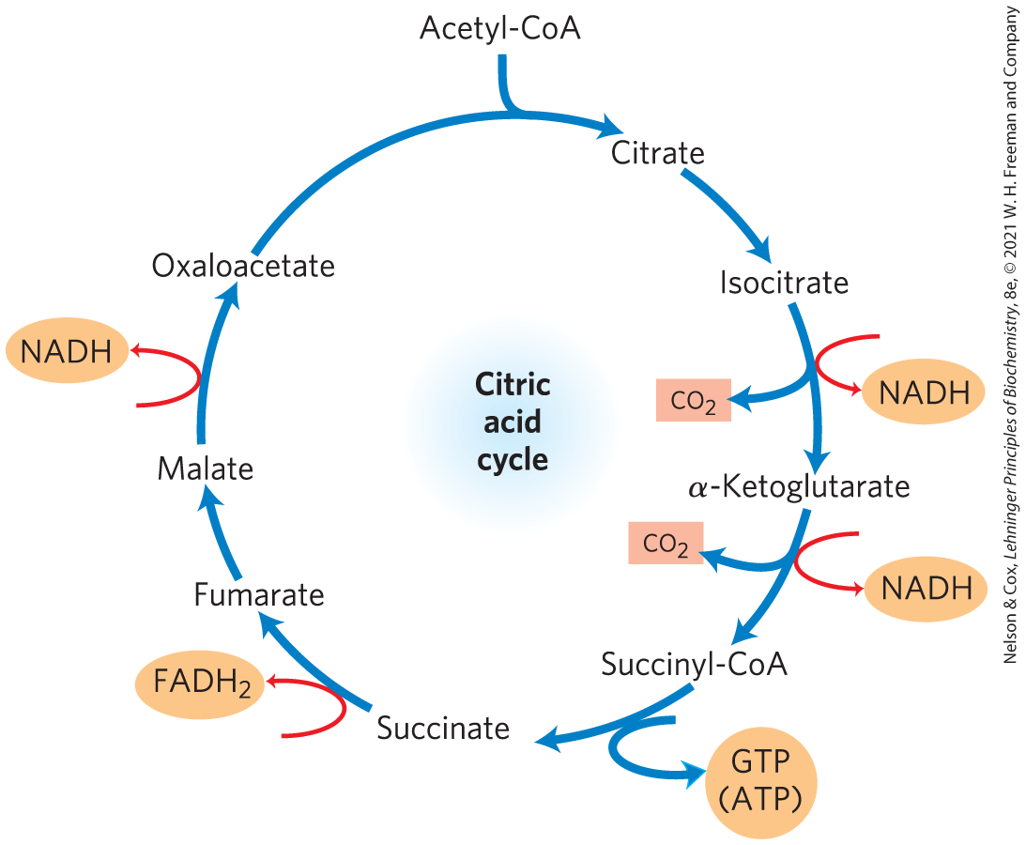
The Energy of Oxidations in the Cycle Is Efficiently Conserved
energy released by oxidation is conserved in the production of:
3 NADH
1 FADH₂
1 GTP (or ATP)

Slide 60
Principle 2 (7 of 7)
The reactions of the citric acid cycle follow a chemical logic. In its catabolic role, the citric acid cycle oxidizes acetyl-CoA to CO₂ and H₂O. Energy from the oxidations in the cycle drives the synthesis of ATP. The chemical strategies for activating groups for oxidation and for conserving energy in the form of reducing power and high-energy compounds are used in many other biochemical pathways.

Slide 61
Electrons from NADH and FADH₂ Enter the Respiratory Chain
the citric acid cycle directly generates only one ATP per turn
the large flow of electrons into the respiratory chain via NADH and FADH₂ leads to formation of almost 10 times more ATP during oxidative phosphorylation
each NADH drives formation of ~2.5 ATP
each FADH₂ drives formation of ~1.5 ATP

Slide 62
Stoichiometry of Coenzyme Reduction and ATP Formation in Aerobic Oxidation of Glucose
Table 16-1 Stoichiometry of Coenzyme Reduction and ATP Formation in the Aerobic Oxidation of Glucose via Glycolysis, the Pyruvate Dehydrogenase Complex Reaction, the Citric Acid Cycle, and Oxidative Phosphorylation
Reaction | Number of ATP or reduced coenzyme directly formed | Number of ATP ultimately formed
Glucose → glucose 6-phosphate | −1 ATP | −1
Fructose 6-phosphate → fructose 1,6-bisphosphate | −1 ATP | −1
2 Glyceraldehyde 3-phosphate → 2 1,3-biphosphoglycerate | 2 NADH | 3 or 5
2 1,3-Bisphosphoglycerate → 2 3-phosphoglycerate | 2 ATP | 2
2 Phosphoenolpyruvate → 2 pyruvate | 2 ATP | 2
2 Pyruvate → 2 acetyl-CoA | 2 NADH | 5
2 Isocitrate → 2 α-ketoglutarate | 2 NADH | 5
2 α-Ketoglutarate → 2 succinyl-CoA | 2 NADH | 5
2 Succinyl-CoA → 2 succinate | 2 ATP (or 2 GTP) | 2
2 Succinate → 2 fumarate | 2 FADH₂ | 3
2 Malate → 2 oxaloacetate | 2 NADH | 5
Total |  | 30-32

Slide 63
16.3 The Hub of Intermediary Metabolism

Slide 64
Principle 3 (2 of 4)
The citric acid cycle is a hub of metabolism, with catabolic pathways leading in and anabolic pathways leading out. Acetate groups (acetyl-CoA) from the catabolism of various fuels are used in the synthesis of such metabolites as amino acids, fatty acids, and sterols. The breakdown products of many amino acids and nucleotides are intermediates of the cycle, and they can be fed in or siphoned off as needed by the cell.

Slide 65
The Citric Acid Cycle Accepts Carbon Skeletons
the cycle accepts 3-, 4-, and 5-carbon skeletons
the breakdown of amino acids yields carbon skeletons:
deaminated aspartate yields oxaloacetate
deaminated glutamate yields α-ketoglutarate

Slide 66
Principle 3 (3 of 4)
The citric acid cycle is a hub of metabolism, with catabolic pathways leading in and anabolic pathways leading out. Acetate groups (acetyl-CoA) from the catabolism of various fuels are used in the synthesis of such metabolites as amino acids, fatty acids, and sterols. The breakdown products of many amino acids and nucleotides are intermediates of the cycle, and they can be fed in or siphoned off as needed by the cell.

Slide 67
The Citric Acid Cycle Serves in Both Catabolic and Anabolic Processes
amphibolic pathway = one that serves in both catabolic and anabolic processes
animals cannot convert acetate or acetyl-CoA to glucose
in the citric acid cycle, there is no net conversion of acetate to oxaloacetate
glyoxylate cycle = reaction sequence that converts acetate to carbohydrate
present in bacteria, plants, fungi, and protists

Slide 68
Principle 3 (4 of 4)
The citric acid cycle is a hub of metabolism, with catabolic pathways leading in and anabolic pathways leading out. Acetate groups (acetyl-CoA) from the catabolism of various fuels are used in the synthesis of such metabolites as amino acids, fatty acids, and sterols. The breakdown products of many amino acids and nucleotides are intermediates of the cycle, and they can be fed in or siphoned off as needed by the cell.

Slide 69
Anaplerotic Reactions Replenish Citric Acid Cycle Intermediates
when intermediates are shunted from the citric acid cycle to other pathways, they are replenished
anaplerotic reactions = chemical reactions that replenish intermediates

Slide 70
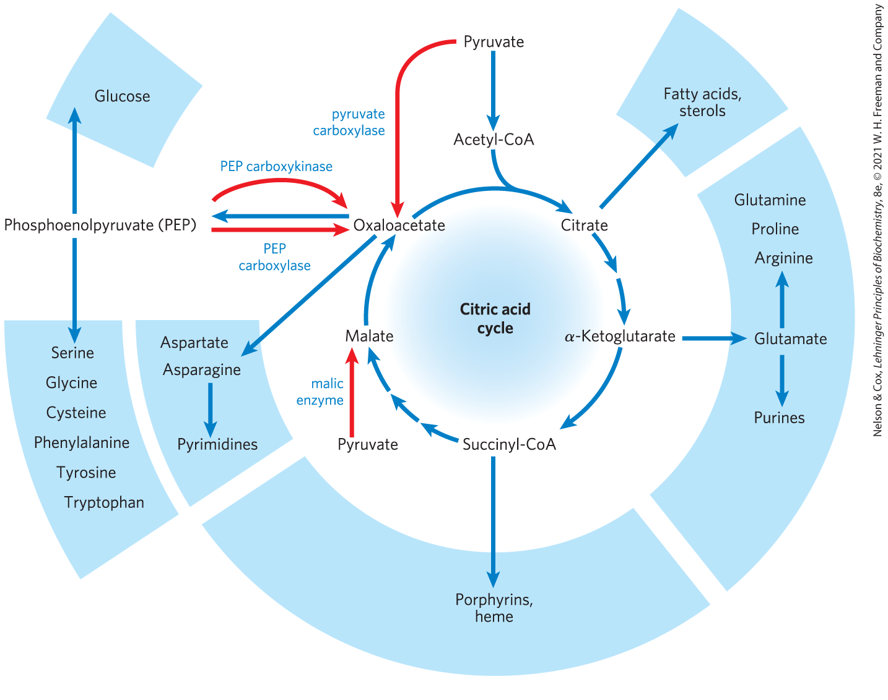
Role of the Citric Acid Cycle in Anabolism

Slide 71
Pyruvate Carboxylase
pyruvate carboxylase = catalyzes the reversible carboxylation of pyruvate by HCO₃⁻ to form oxaloacetate
most important anaplerotic reaction in mammalian liver, kidney, and brown adipose tissue
requires energy from ATP
allosterically activated by acetyl-CoA

Slide 72
Biotin in Pyruvate Carboxylase Carries One-Carbon (CO₂) Groups
biotin = vitamin that acts as a specialized carrier of one-carbon groups as CO₂ in many carboxylation reactions
serves as the prosthetic group of pyruvate carboxylase

Slide 73
Principle 5 (6 of 6)
Enzymes have evolved to form complexes to efficiently achieve a series of chemical transformations without releasing the intermediates into the bulk solvent. This strategy, seen in the pyruvate dehydrogenase complex and the metabolons of the citric acid cycle, is ubiquitous in other pathways of metabolism, in respiration, and in the many “ — somes” that assemble and disassemble informational macromolecules.

Slide 74
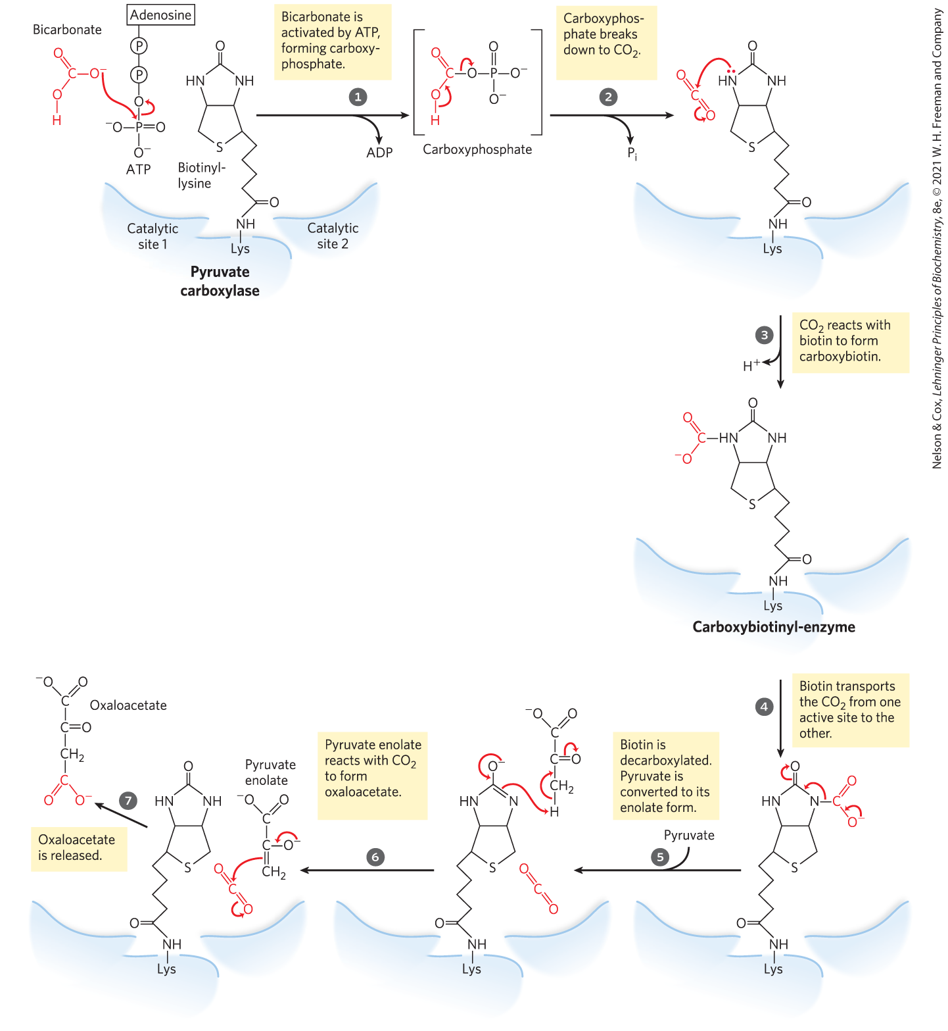
The Role of Biotin in the Pyruvate Carboxylase Reaction
the two steps in carboxylation of pyruvate occur at separate active sites
the arm of biotin transfers activated carboxyl groups from the first active site to the second

Slide 75
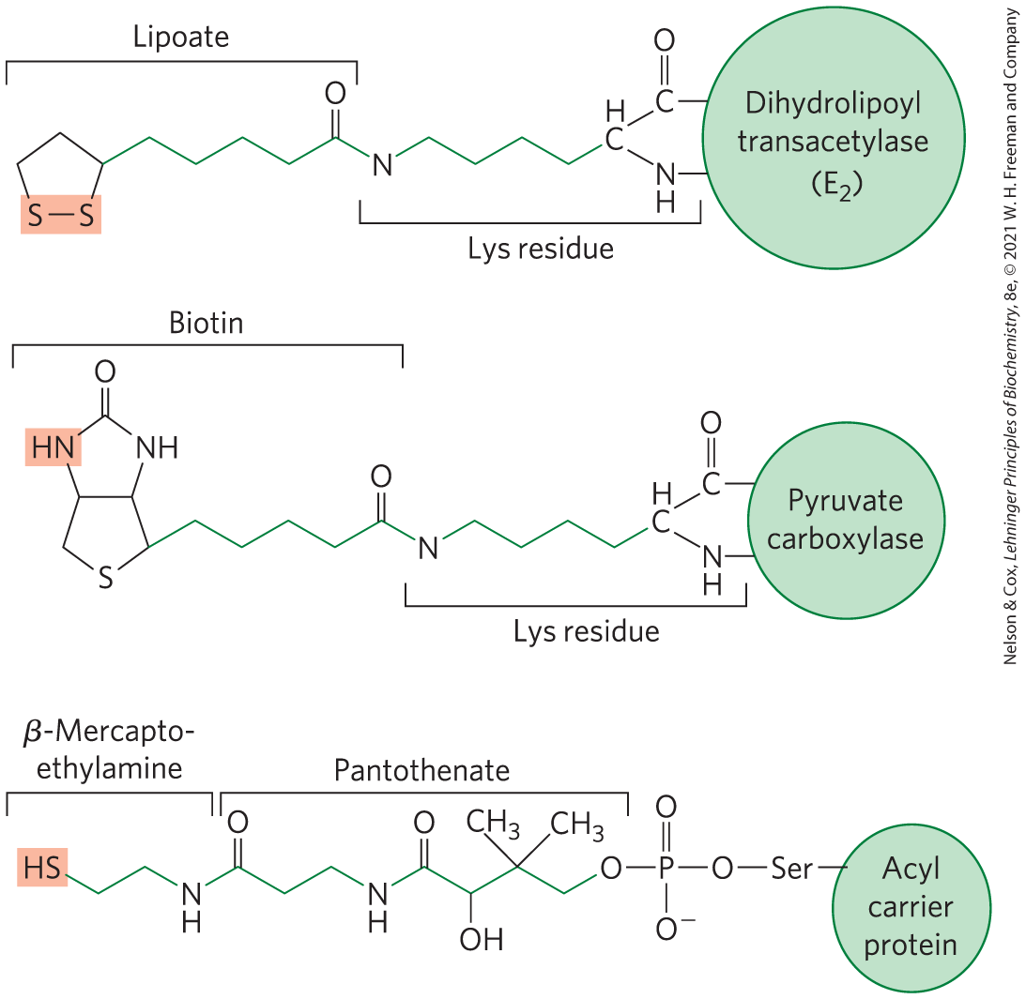
Biological Tethers Allow Flexibility
all participate in substrate channeling through the flexible tethers that move intermediates from one active site to the next

Slide 76
16.4 Regulation of the Citric Acid Cycle

Slide 77
Principle 4 (3 of 5)
The central role of the citric acid cycle in metabolism requires that it be regulated in coordination with many other pathways. Regulation occurs by both allosteric and covalent mechanisms that overlap and interact to achieve homeostasis. Some mutations that affect the reactions of the citric acid cycle lead to tumor formation.

Slide 78
Citric Acid Cycle Regulation
regulation balances the supply of key intermediates with the demands of energy production and biosynthetic processes
regulation occurs at several points:
PDH complex
citrate synthase
isocitrate dehydrogenase complex
α-ketoglutarate dehydrogenase complex

Slide 79
Principle 1 (3 of 4)
Pyruvate is the metabolite that links two central catabolic pathways, glycolysis and the citric acid cycle. It is therefore a logical point for regulation that determines the rate of catabolic activity and the partitioning of pyruvate among its possible uses.

Slide 80
Production of Acetyl-CoA by the PDH Complex Is Regulated by Allosteric and Covalent Mechanisms
PDH complex activity is turned off when:
ample fatty acids and acetyl-CoA are available as fuel
[ATP]/[ADP] and [NADH]/[NAD⁺] ratios are high
PDH complex activity is turned on when:
energy demands are high
the cell requires greater flux of acetyl-CoA into the citric acid cycle

Slide 81
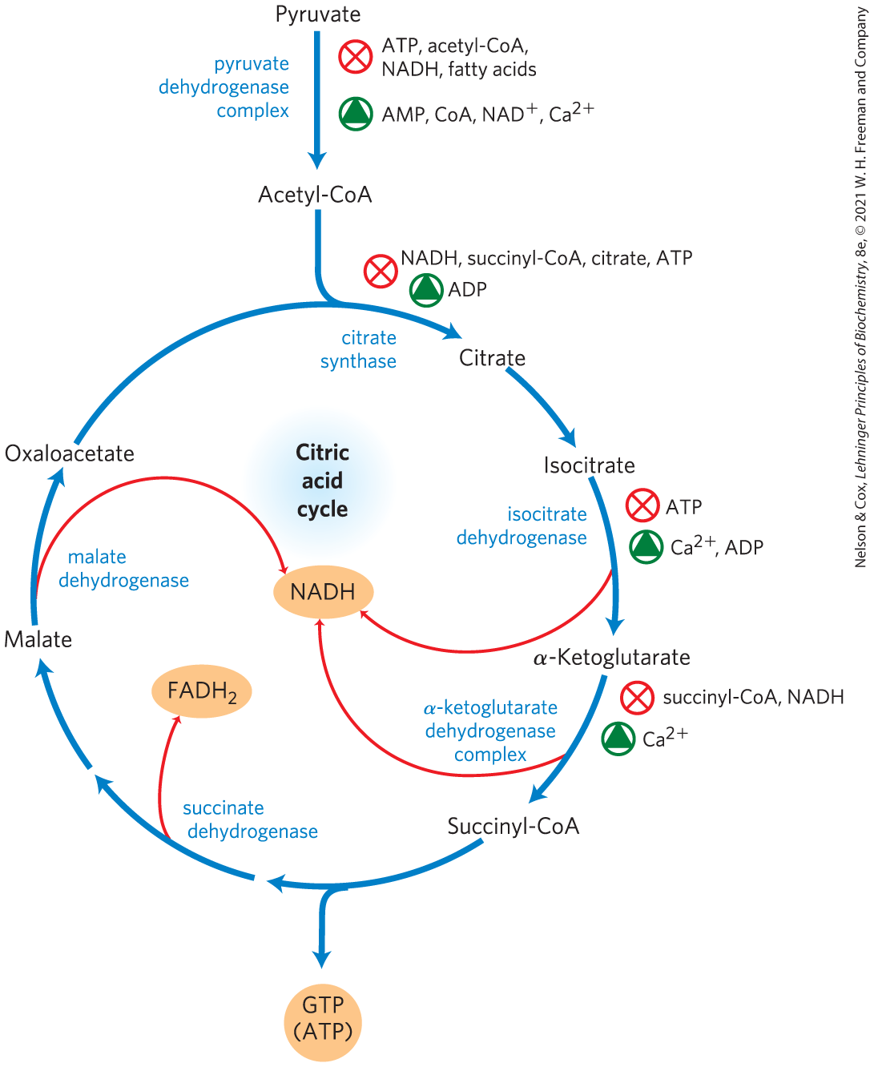
Regulation of Metabolite Flow Through the Citric Acid Cycle

Slide 82
Principle 1 (4 of 4)
Pyruvate is the metabolite that links two central catabolic pathways, glycolysis and the citric acid cycle. It is therefore a logical point for regulation that determines the rate of catabolic activity and the partitioning of pyruvate among its possible uses.

Slide 83
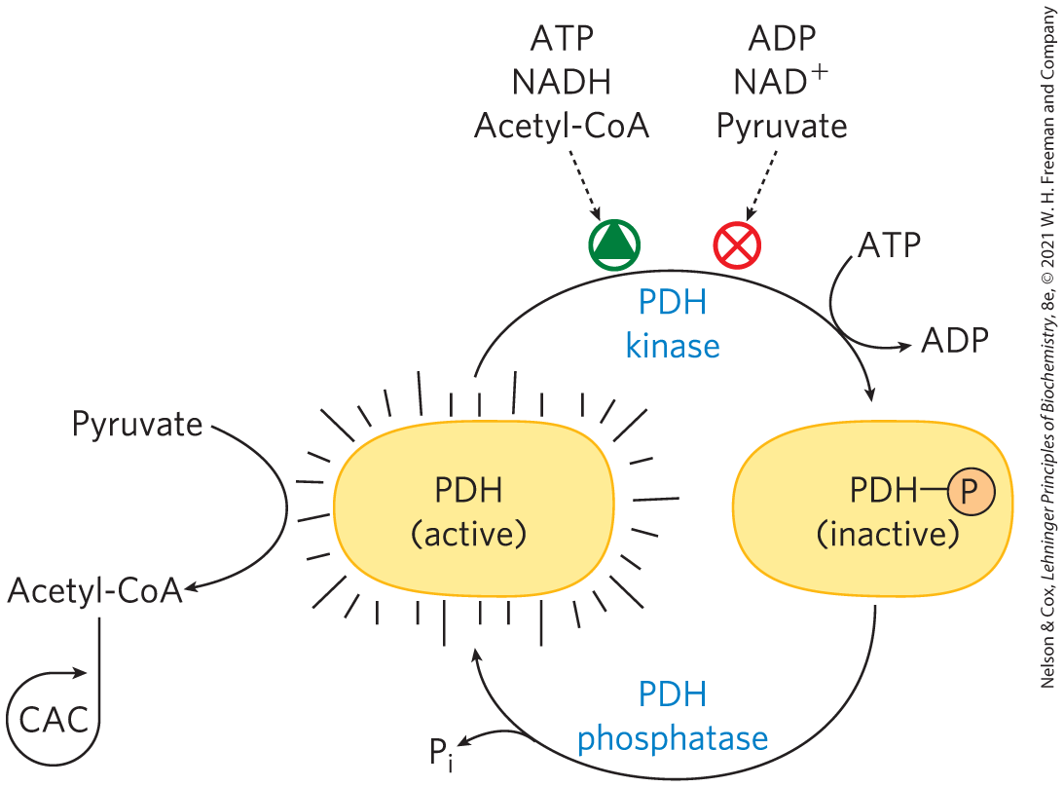
Covalent Modification of the PDH Complex
PDH kinase = inhibits the PDH complex by phosphorylation
allosterically activated by products of the complex
inhibited by substrates of the complex
PDH phosphatase = reverses the inhibition by PDH kinase

Slide 84
Principle 4 (4 of 5)
The central role of the citric acid cycle in metabolism requires that it be regulated in coordination with many other pathways. Regulation occurs by both allosteric and covalent mechanisms that overlap and interact to achieve homeostasis. Some mutations that affect the reactions of the citric acid cycle lead to tumor formation.

Slide 85
The Citric Acid Cycle Is Also Regulated at Three Exergonic Steps
regulation occurs at strongly exergonic steps catalyzed by:
citrate synthase
isocitrate dehydrogenase complex
α-ketoglutarate dehydrogenase complex
fluxes are affected by the concentrations of substrates and products:
end products ATP and NADH are inhibitory
NAD⁺ and ADP are stimulatory
long-chain fatty acids are inhibitory

Slide 86
Citric Acid Cycle Activity Changes in Tumors
some mutations that affect the PDH complex or citric acid cycle enzymes are oncogenic:
downregulation of mitochondrial pyruvate carrier (MPC)
inactivation of PDH complex
inactivation of succinate dehydrogenase
oncometabolites = stimulate tumor growth by acting though specific GPCRs in the plasma membrane

Slide 87
Lactate and Succinate Are Oncometabolites
tumor cells accumulate lactate and succinate
oncometabolites = stimulate tumor growth by acting though specific GPCRs in the plasma membrane

Slide 88
Principle 4 (5 of 5)
The central role of the citric acid cycle in metabolism requires that it be regulated in coordination with many other pathways. Regulation occurs by both allosteric and covalent mechanisms that overlap and interact to achieve homeostasis. Some mutations that affect the reactions of the citric acid cycle lead to tumor formation.

Slide 89
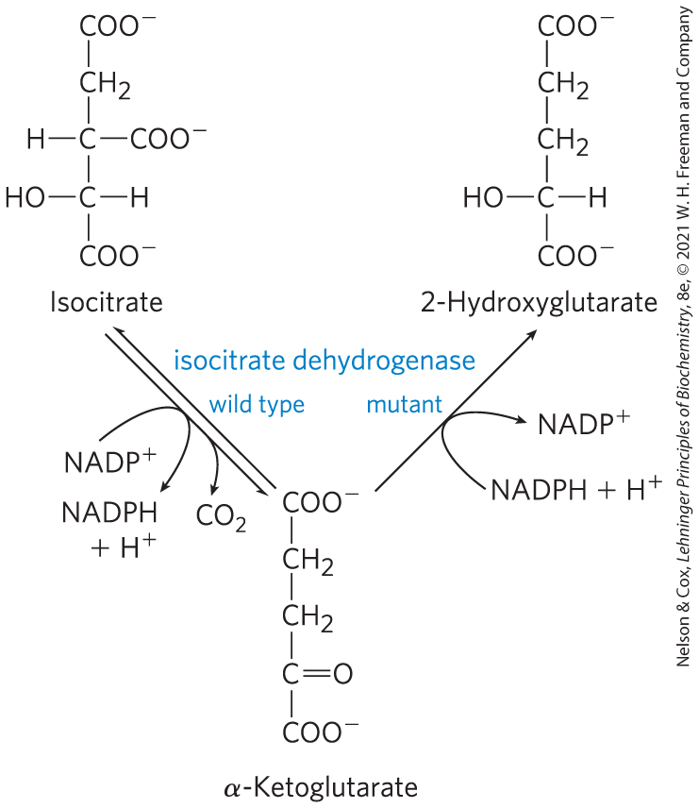
Mutations in Citric Acid Cycle Enzymes
mutations in succinate dehydrogenase and fumarase cause tumors, defining them as tumor suppressors
many glial cell tumors have mutant NADPH-dependent isocitrate dehydrogenase
lose ability to convert isocitrate to α-ketoglutarate
gain ability to convert α-ketoglutarate to 2-hydroxyglutarate

Slide 90
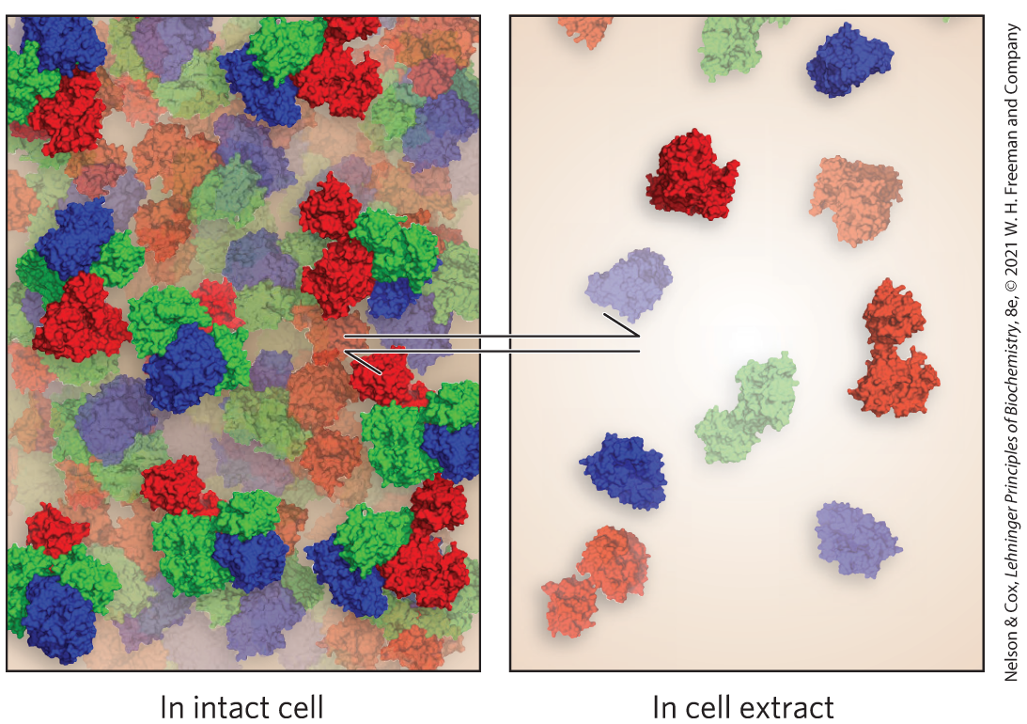
Certain Intermediates Are Channeled through Metabolons
metabolons = integrated multienzyme complexes that are held together by noncovalent interactions
malate dehydrogenase, citrate synthase, and aconitase likely constitute a metabolon

